Slide 1


SAP CLOUD APPLICATION PROGRAMMING AND XSA TRAINING IN BTP
Anubhav Oberoy
Day – 2

Slide 2

Agenda – Day 2
Functions in JavaScript
Asynchronous Behavior of JavaScript
Concept of Events in NodeJS
Introduction to Node Package Manager (NPM)
Accessing the global modules
Steps to Initialize a NodeJS Project
Creating a server using NodeJS and Express module
Creating Microservice using NodeJS
Introduction to SAP HANA Cloud
Instances and Service in HANA Cloud
Difference between SAP HANA Cloud and On-Premise
Understanding the concept of HDI containers
Introduction to SAP CAP
SAP CAP Architecture
Why we use SAP CAP
Create the Dev Space for CAP Development
Creating our First CAPM project
Configuring the project for HANA specific development
Creating our first service
Introduction to the Git and GitHub
Creating our first git repository
Adding our project to the Git Repository

Slide 3
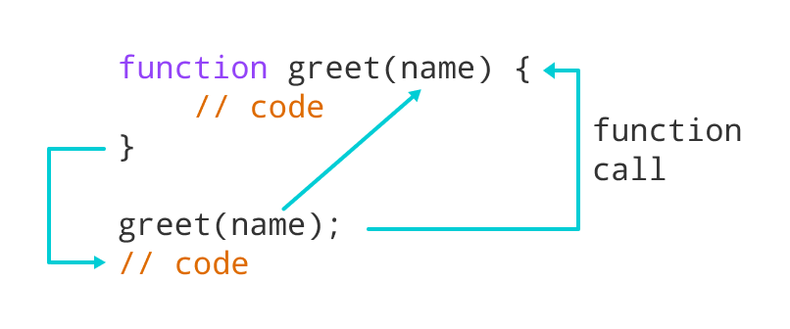
Functions in JavaScript
Functions in JavaScript
A JavaScript function is a block of code designed to perform a particular task.
A JavaScript function is executed when "something" invokes it (calls it).
A JavaScript function is defined with the function keyword, followed by a name, followed by parentheses ().
The code to be executed, by the function, is placed inside curly brackets: {}
Function parameters are listed inside the parentheses () in the function definition.
Function arguments are the values received by the function when it is invoked.
Inside the function, the arguments (the parameters) behave as local variables.
Types of functions
Functions are of 2 types →
1. Anonymous function
function(params) {
//code
}
2. Named Function
function functionName(params) {
//code
}

Slide 4

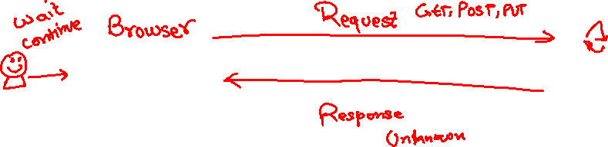
Exercise
In this exercise we will see how we create functions in JavaScript and what are the different syntaxes of defining the functions. Along with that we will see the concept of reusable modules in NodeJS and with that we will see the use of Global Variables.
Part 1: Named Function Basics
FunctionBasic.js
Part 2: Concept of Reusable module in NodeJS
FunctionBaisc.js
reuse.js
Part 3: New Syntax of defining function and Global variable
FunctionBasic.js
JS is asynchronous Non Blocking Programming language. Also is an event driven programming language.
Server
Java
ABAP
Client
Java Script
Node JS
Java Script

Slide 5
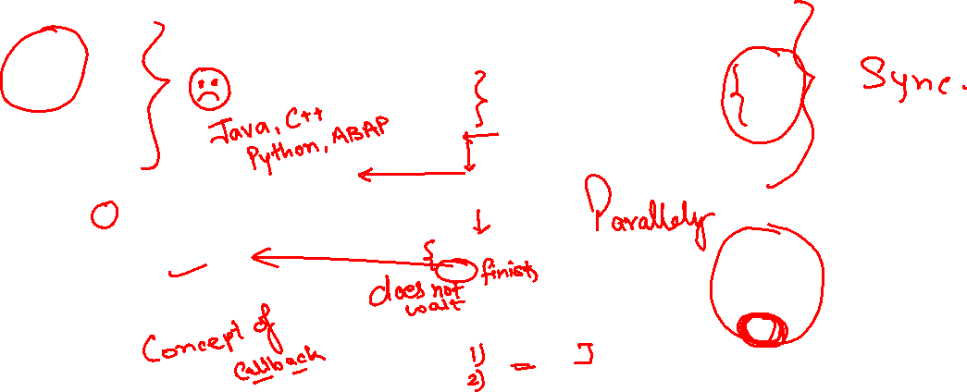
Asynchronous behavior of JavaScript
UI
Module
w
async
Util (in-built)
Callbacks
Promise

Slide 6

Exercise
In this exercise we will see the asynchronous behavior of JavaScript. We will see the use of Callback function and Promise in JavaScript. Along with that we will see the JavaScript’s reusable module ‘util’ to promisify a function.
Part 1: Concept of Callback Function
AsyncFunciton.js
Part 2: Concept of Promise in JavaScript
AsyncFunction.js
Part 3: Promise using a reusable module.
AsyncFunction.js

Slide 7

Concept of Events in NodeJS - Exercise
Node.js has an event-driven architecture which can perform asynchronous tasks. Node.js has ‘events’ module which emits named events that can cause corresponding functions or callbacks to be called.
In this exercise we see how to use events in NodeJS. We will see Simple events as well as How to use events in Real life examples.
Part 1: Simple Event Example
EventConcept.js
Part 2: Event Concept using Real Life example
EventConcept.js

Slide 8
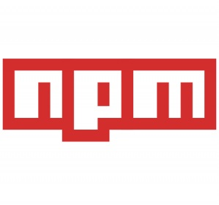
NPM – Node Package Manager
Node Package Manager (NPM) is a command line tool that installs, updates or uninstalls Node.js packages in your application. It is also an online repository for open-source Node.js packages. The node community around the world creates useful modules and publishes them as packages in this repository.
npm is the world's largest Software Registry.
The registry contains over 800,000 code packages.
Open-source developers use npm to share software.
Many organizations also use npm to manage private development.
npm is installed with Node.js
NPM is included with Node.js installation. After you install Node.js, verify NPM installation by writing the following command in terminal or command prompt ‘npm –v’
https://www.npmjs.com/

Slide 9
Access Global Node JS Modules
We can add the Global modules present on the NPM repository in our project.
To include the modules in our project we can use the following npm command:
‘npm install <moduleName>’
This command will Keep the module within the project, if we want to use that module in another project then we have to install it again in that project also.
Now if we want add a module which can be shared within all the projects, then we have to install that module globally in our system. To do that we have to use the following npm command:
‘npm install –g <moduleName>’
If there is a utility, command line tools we install them globally
package.json
project
project
project
local
global
global
module
Package.json file
Information about our project name, author, version
All the dependencies required by this node project
When we deploy our project in another system/machine we can use npm install command
module

Slide 10
Steps to create a Fresh NodeJS Project
Run a command called npm init – Create a new Nodejs project
Answer some simple questions like project name, starring file, author, version, description, …
As we mentioned that our starting file will be index.js. So now we have to create a new file named index.js.
We can just add some code to this file with all the modules
Then we run npm install moduleName --save OR npm install moduleName --save-dev to add a module to our project.
To run the project, we can use the ‘node .’ command in the terminal.
Exercise: In this exercise we will create our first NodeJS project following the above steps.
index.js
Phase 2 – Create a webserver and microservice using ‘express’
Install express module and add that as dependency also to our project npm install express –save
You can check package.json and you will find dependencies
Use express module to create web server (refer index.js file)

Slide 11

Exercise
In this exercise we will create a simple microservice using the NodeJS and express server module.
Part 1: Creating a Simple NodeJS app with express server
index.js
Part 2: Creating a Microservice which return a JSON data
index.js

Slide 12
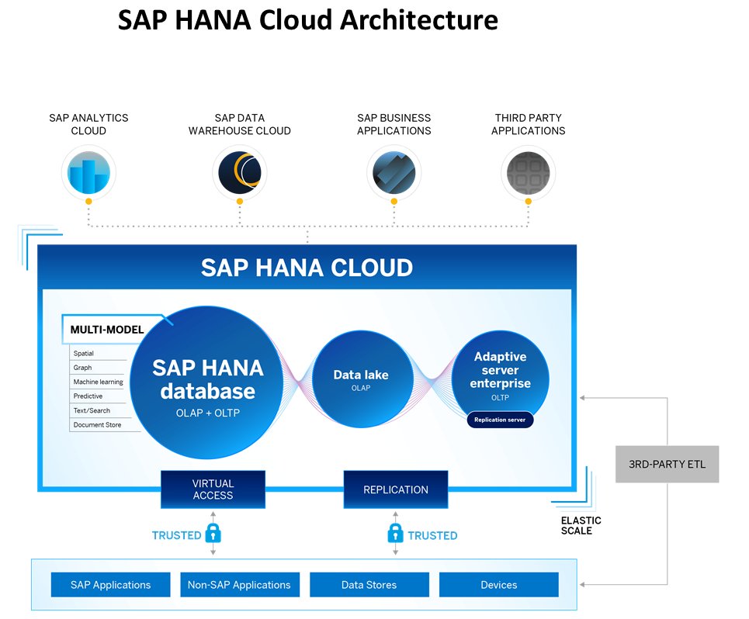
What is SAP HANA Cloud?
SAP HANA Cloud is a fully managed, in-memory, cloud database as a service (DBaaS). It is the cloud-based data foundation for SAP Business Technology Platform. With SAP HANA Cloud you can create, run, and extend new and existing applications.
SAP HANA Cloud includes a number of software components. The core component is SAP HANA Database, but other components can be added at any time, such as a data lake.
Key Components of SAP HANA Cloud
There are four key components of SAP HANA Cloud:
SAP HANA Cloud, SAP HANA Database
In-memory database with built-in advanced analytics (spatial, graph, text, etc.)
SAP HANA Cloud, data lake
Store and query large data sets and most file types
SAP HANA Cloud, adaptive server enterprise
Support for extreme –performance transactional applications
SAP HANA Cloud, adaptive server enterprise replication
Bi-directional real time data replication across databases

Slide 13
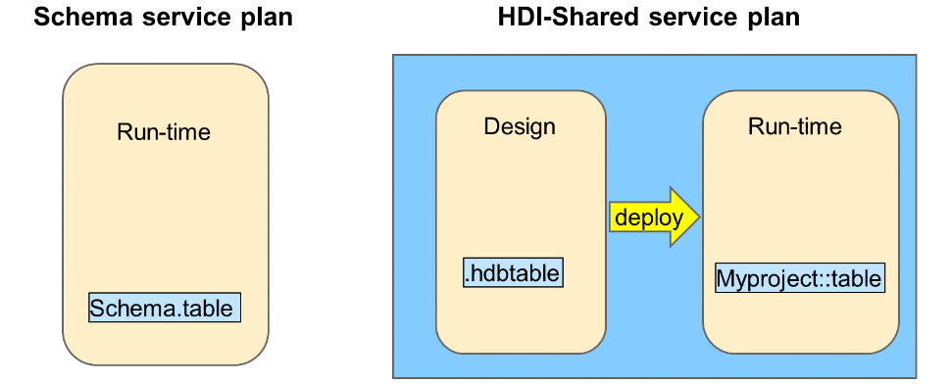
Interfaces and Services in SAP HANA Cloud
Business Application Studio (BAS) - Used by developers to build and maintain applications. Developers include application coders and also data modelers. Business Application Studio is the recommended tool for developing Cloud Foundry applications.
Web IDE - The original interface used by developers to build applications. Although Web IDE can be used with SAP HANA Cloud, it is recommended to use Business Application Studio.
Database Explorer - This is an interface that is used by developers and also administrators. The Database Explorer is used to explore the run-time objects of the database, for example, tables, views and stored procedures.
SAP HANA Cockpit - Used by administrators to monitor the platform, optimize performance, maintain security, and trace and analyze errors.
Service Plans
When you provision an SAP HANA Cloud database, you choose a service plan to manage the database artifacts.
SAP HANA Cloud provides a choice of two service plans for managing database artifacts:
Schema service plan — Create all database artifacts directly to schemas using SQL.
HANA Deployment Infrastructure (HDI) Shared service plan — Provides a combined database design-time and run-time environment. Database developers, using this plan, define all database objects using source files.
NOTE: - A service plan will only be available to you if it was already added as a service entitlement which is done at the Business Technology Platform (BTP) global account level.
Notes:
SAP HANA Cloud provides a choice of two service plans for managing database artifacts:
Schema service plan — Create all database artifacts directly to schemas using SQL. This run-time only option is the approach that has been used for many years with traditional databases and appeals to organizations that only need a database to power their applications and do not require design-time tooling to define the database artifacts as source files. You will manually define schemas to manage your database run-time objects.
HANA Deployment Infrastructure (HDI) Shared service plan — Provides a combined database design-time and run-time environment. Database developers, using this plan, define all database objects using source files. The source files are used to generate and deploy the run-time object to the containers. This plan provides tools for the full life-cycle development and deployment of database artifacts. With this plan you don't have to worry about schemas as these are invisible to the developer and managed by the HDI framework. This is known as schema-less development and provides a flexible re-deployment model as database artifacts are not hardwired to schemas.
A service plan will only be available to you if it was already added as a service entitlement which is done at the Business Technology Platform (BTP) global account level.
A service plan is chosen when you create a new Instance. An Instance belongs to a Space

Slide 14
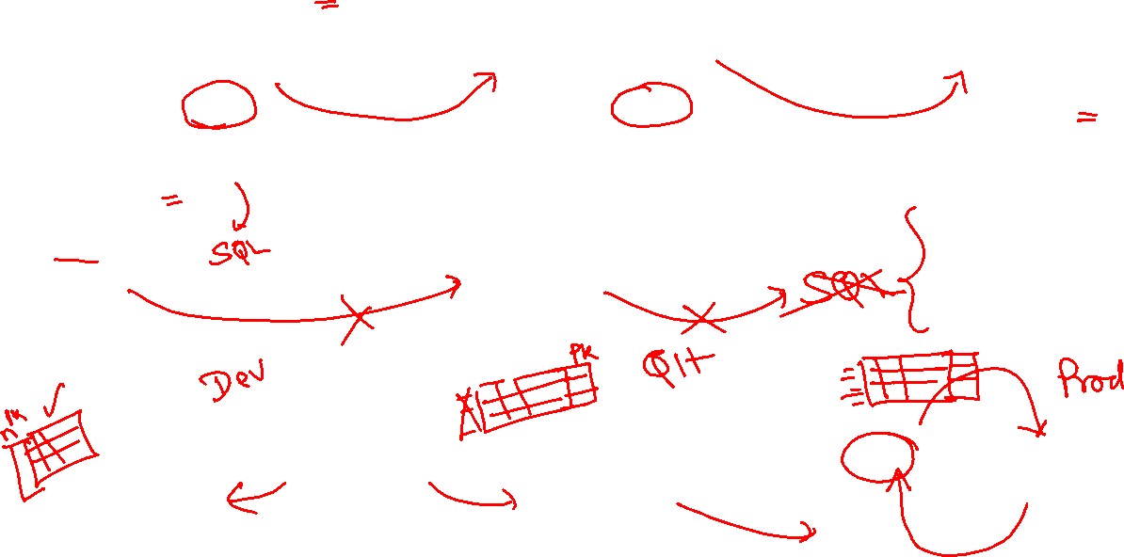
{
Key name,
Key id
Sal, curr
}
{
Key name,
Sal, curr
}
{
Key name,
Sal, curr
}
Design time object
Package
.cds
Design time object
Design time object
active
active
active
Index Server
Index Server
Index Server
ALTER TABLE emp
Name pk
ID pk
Sal
curr
ALTER TABLE emp
Name pk
ID pk
Sal
curr
ALTER TABLE emp
Name pk
ID pk
Sal
curr
D
5rex
Q
0rec
P
10rec
Run time object
Schema
temp

Slide 15
Fiori App
Xsjs, xsodata
XS Project
order.hdbtable
FIN.hdbschema
Multiple developers working with same schema introduce risk of updating other developer data and cause failure in test.
We are moving to cloud, in the cloud we have services, services are the only way to communicate with software. HDI service, HANA Deployment Infrastructure service in cf to manage db schema. These new db schema are called HDI Container, Self managed by application.
10 Recs, 100->150, 250
Dev team – Schema

Slide 16
HDI Container
An HDI Container is also a schema. But it is managed differently from a normal schema.
How its created?
Manually create it in BTP
Application Managed HDI Container (You as developer ONLY work with App, App will talk to HANA to create and manage this schema to store/read data internally)
You cant access HDI Container using HANA Studio (Deprecated tool), We can use new SAP HANA Database Explorer, SAP HANA WebIDE for OP or BAS to access HDI Container.
Who creates it?
There is a new service in SAP HANA called SAP HDI (HANA Deployer Infrastructure) which is just a microservice responsible to managing the container. HDI Deployer is a component which is used to talk to this service from our app.
Who owns it?
The moment HDI Container is created, 2 users will gets created automatically by system in HANA.
RANDOMGUID_DT (Design Time) – Full permission to CREATE< DROP< ALTER DB object
RANDOMGUID_RT (Runtime User) – Only permissions to INSERT, UPDATE, DELETE data…
In case of app wants to talk to hana, these users will be used by our app. The same user will be available as environment variable in CF, VCAP_SERVICE.

Slide 17
HDI and Container
HDI (HANA Deployment Infra) Service
HANA DB (shared-db)
HDI Container
HDI Container
HDI Container
HDI Container
HDI Container

Slide 18
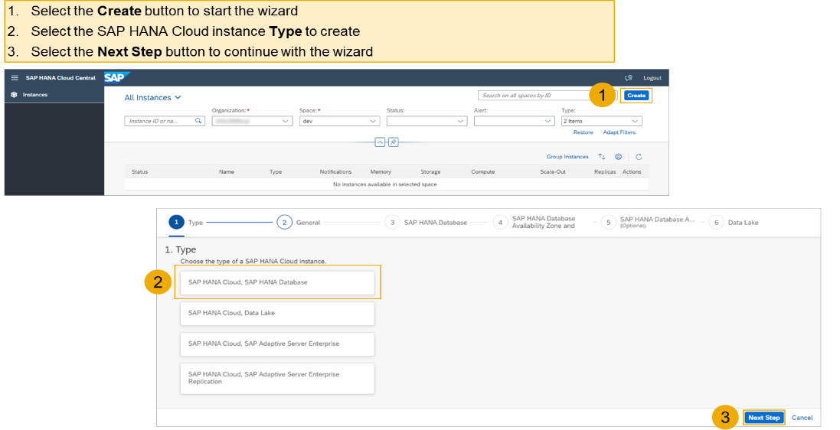
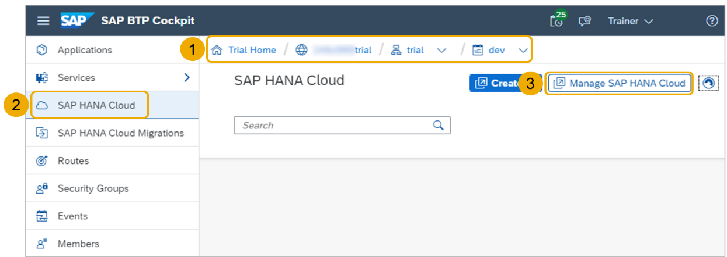
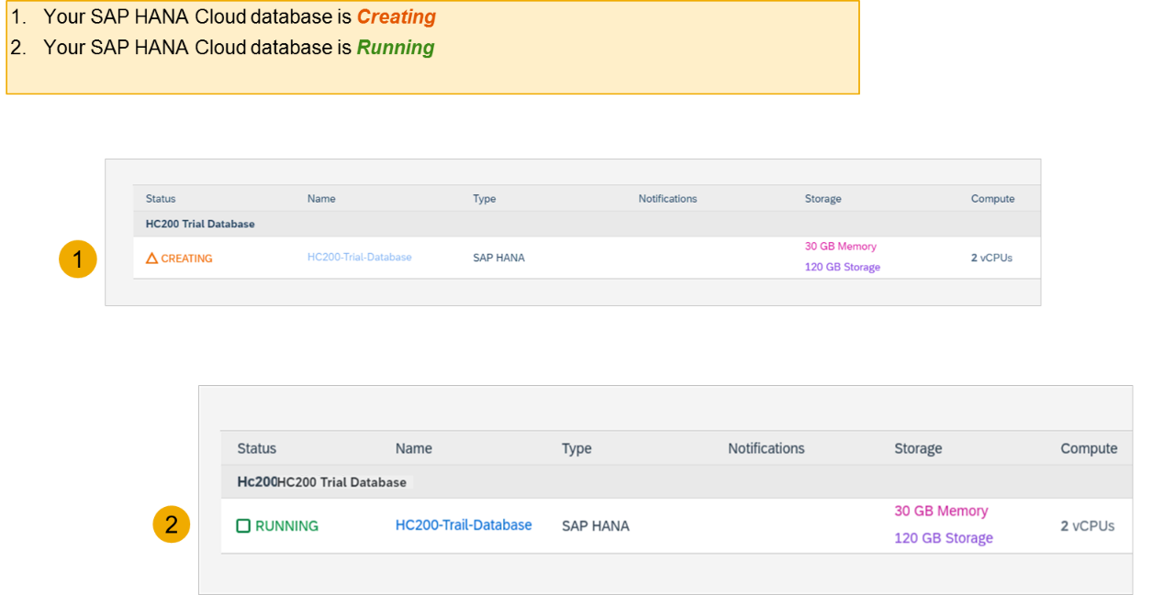
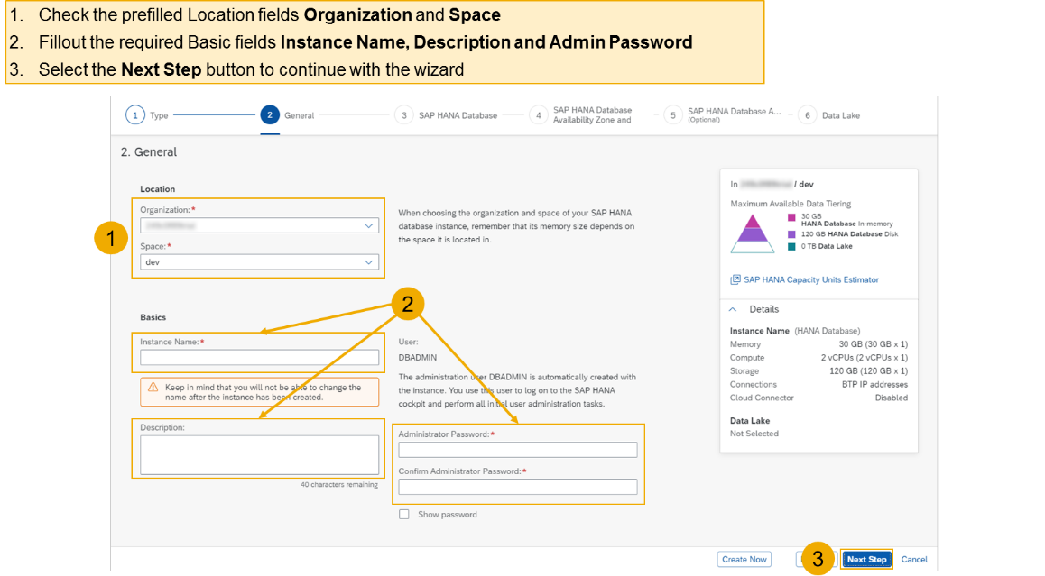
Creating SAP HANA Cloud Instance
Login to your trial and navigate to your dev space
Select SAP HANA Cloud
Select the Manage SAP HANA Cloud button to start the SAP HANA Cloud Central
Select the Create button to start the wizard
Select the SAP HANA Cloud instance Type to create
Select the Next Step button to continue

Slide 19
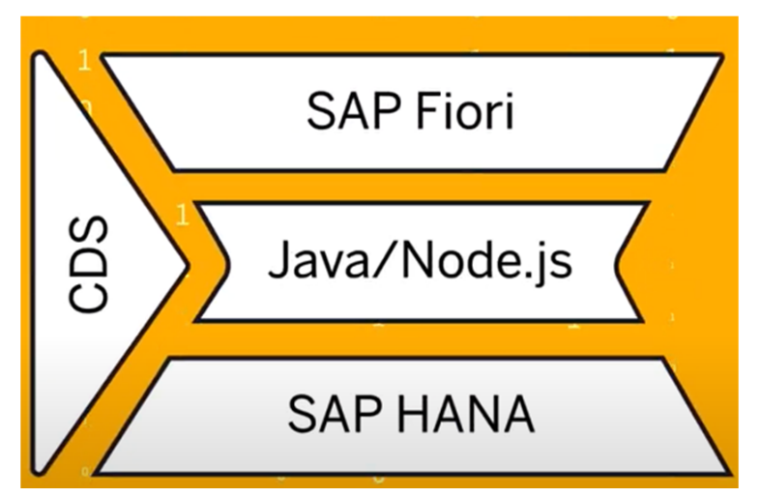
Introduction to SAP CAP
SAP Cloud Application Programming Model, also referred to as SAP CAP, is a framework of tools, languages, libraries and APIs that combine open-source and SAP provided tools and technologies.
A very important aspect of SAP CAP is that it provides SAP best practices to help developers reduce their coding efforts.
The idea behind CAP is that it encourages developers to focus on the added value part of the application (the domain) and not on the low value recurring, technical features of an application that can easily be provided by the model and that could change across different environments.
SAP CAP is used for new application developments and also to extend existing SAP applications.
The backbone of CAP is Core Data Services (CDS)
CDS is used to define the core data layer.
CDS also includes an advanced querying language called Core Query Language (CQL).
Concept of CDS – Core Data & Services
Conceptually CDS is same concept but different flavor. The concept says, that we will have a design time object which is named as CDS File. We will create a .cds file for almost everything e.g. service, DB artefact, annotation. This is a design time file and the SAP’s framework (CAPM, RAP), will convert this design time definition after compilation to the runtime object.
Basic Layer of Cloud Application Programming Model

Slide 20
Why we need CAP Model?
What is SAP’s recommendations to build Cloud Native apps in BTP → Best-practice
Are there any gold standard which industry should follow w.r.t. SAP BTP
Many times as a developer, I need to take care of loading all required dependencies
Reusability of code which can speed up my development
As a developer I want to focus more on functionality then the project setup
Tight Coupling to DB or technology
Dependency on SQL
No matter which area we belong SO, PO, MM, PM, PJ, APO, CRM…FI etc.
CAPM
(CDS Engine)
Node Dependency
Database Related Code
Ex: HANA Code,
SQL Code,
Postgre SQL Code, etc.
Application (package.json)
File.cds (definition)
Entity orders{
Id integer;
Company string;
Amount decimal(12,2);
}

Slide 21
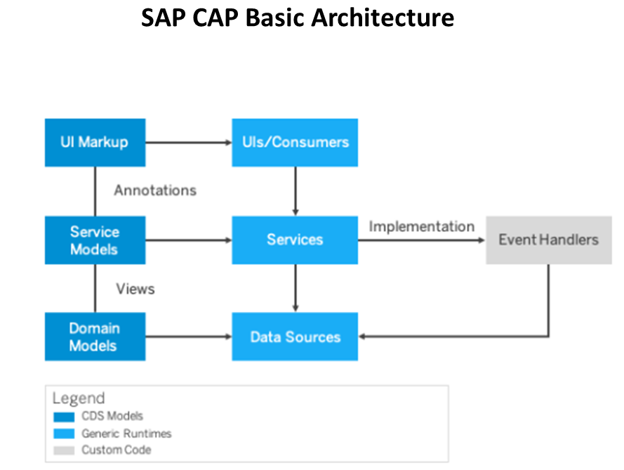
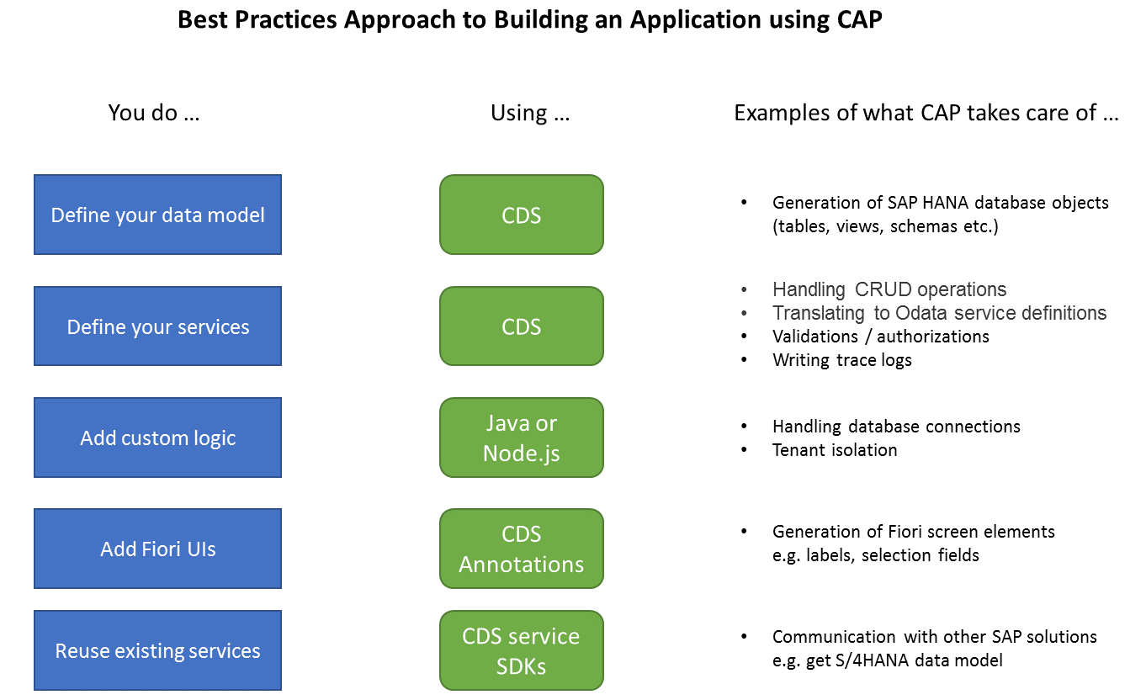
Architecture of SAP CAP
A key concept within CAP is that everything is a service
Services expose a consistent set of APIs that can be consumed by all other services and front ends.
Services are defined in CDS and define what should happen and when and to what data.

Slide 22

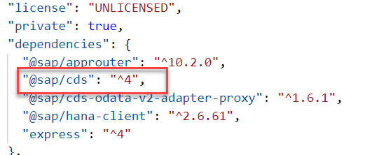
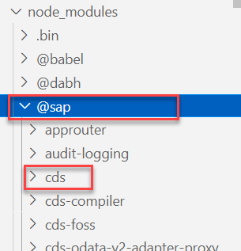
Introduction to CDS-DK
CDS-SDK stands for CDS Development Kit.
It is a command line client and development toolkit for the SAP Cloud Application Programming Model (CAP).
To install this tool in our local system we need to run the command
To install globally: npm i -g @sap/cds-dk
To install in local project: npm i @sap/cds-dk
End-use
or CF app
Developer
@sap/cds-dk
Applications
@sap/cds
@sap/cds
@sap/cds-dk is a development kit. It is used by the developer only at the time of initializing a new CAP project.
@sap/cds-dk contains the @sap/cds library.
@sap/cds is a module which is used at the runtime of an application to convert all the .cds artifacts in a database specific format.
@sap/cds is separately installed in our project using the command npm install @sap/cds.
@sap/cds is required by the Cloud Foundry application at the Runtime.

Slide 23
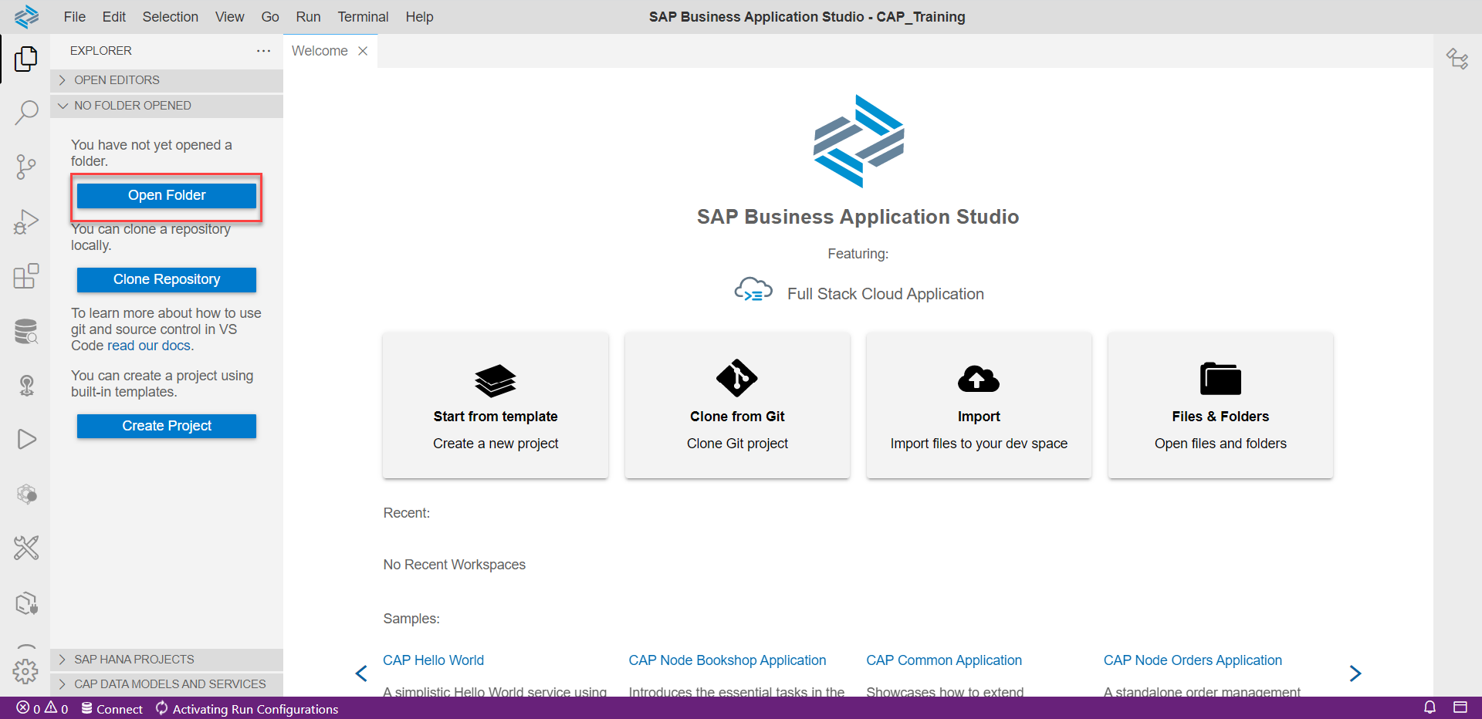
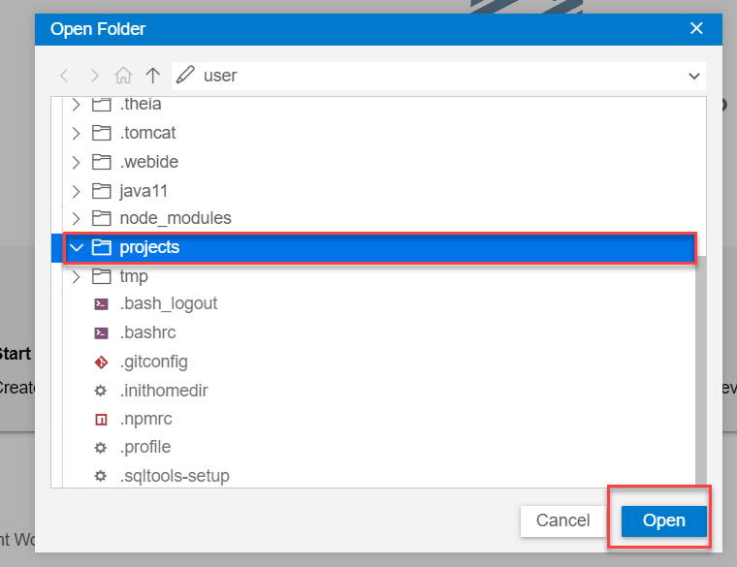
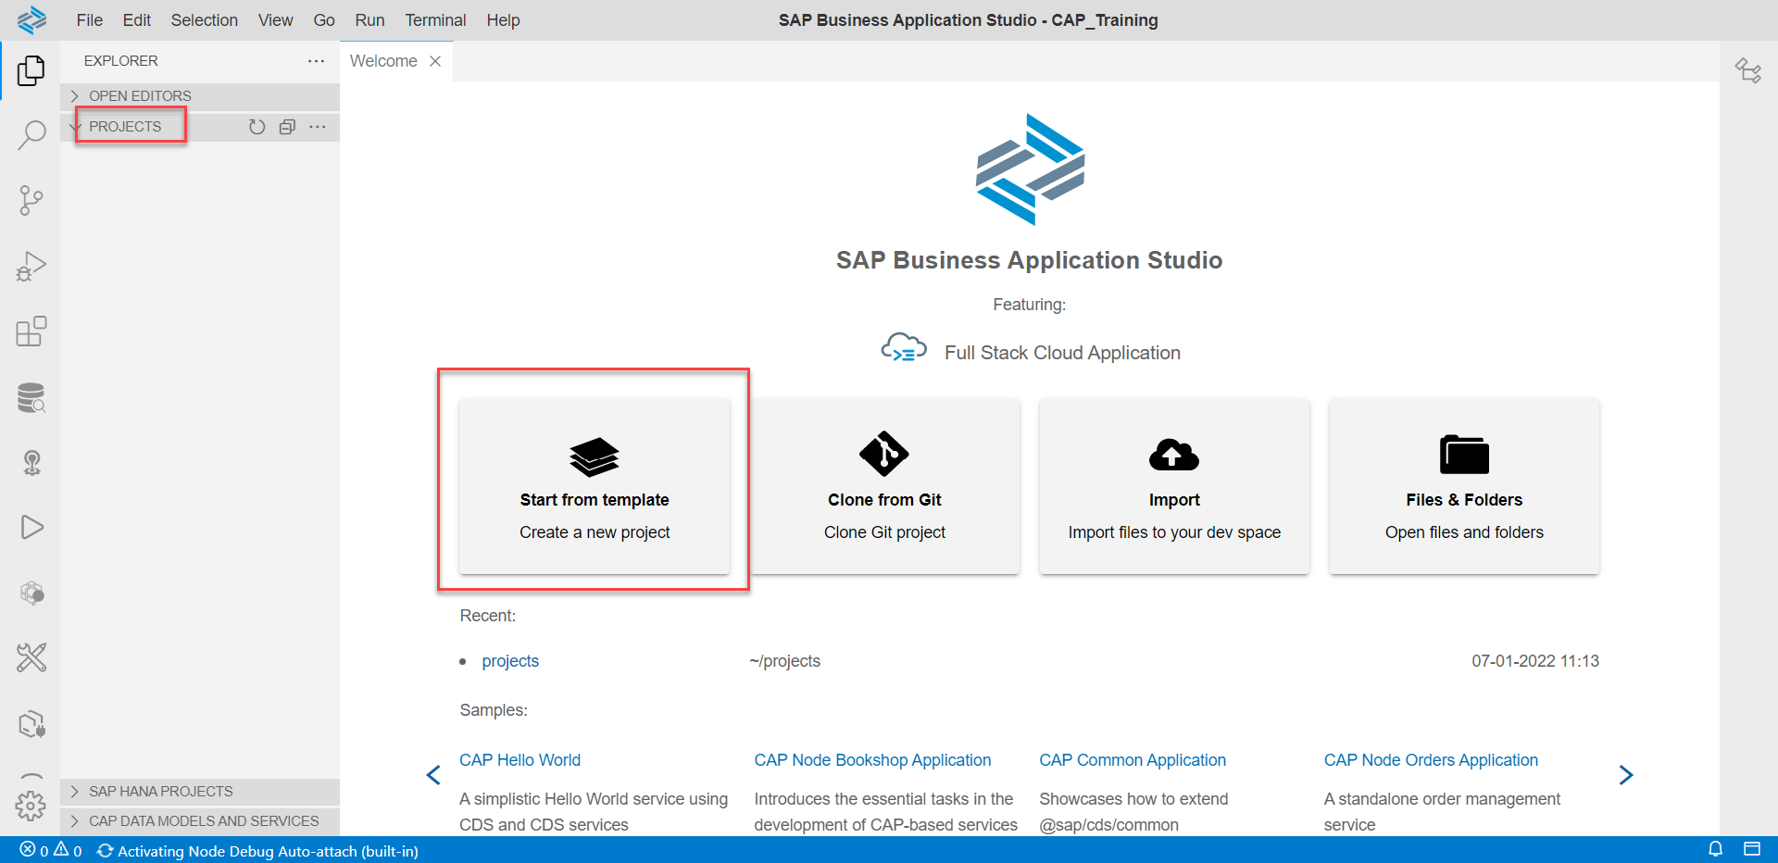
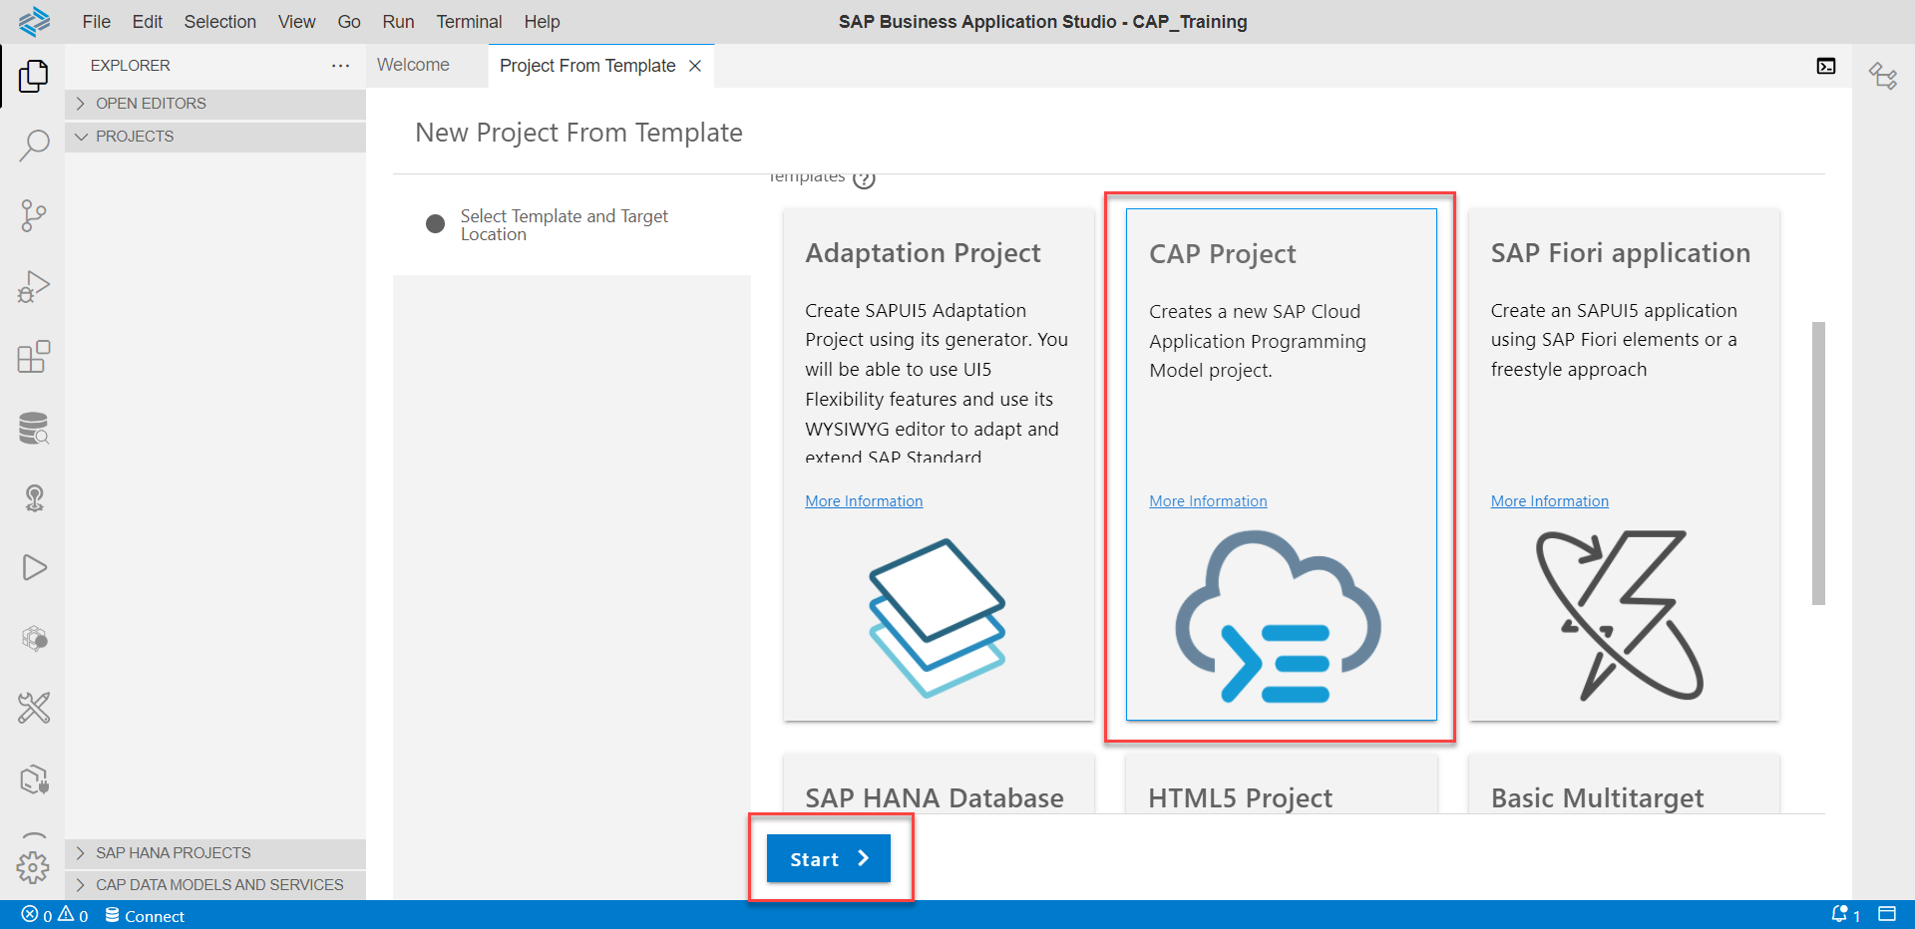
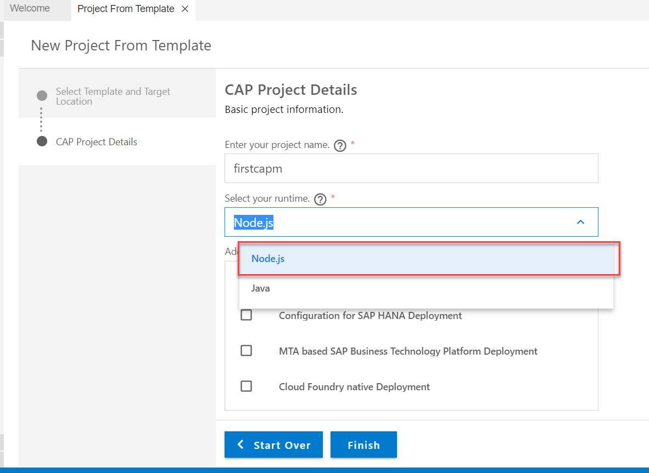
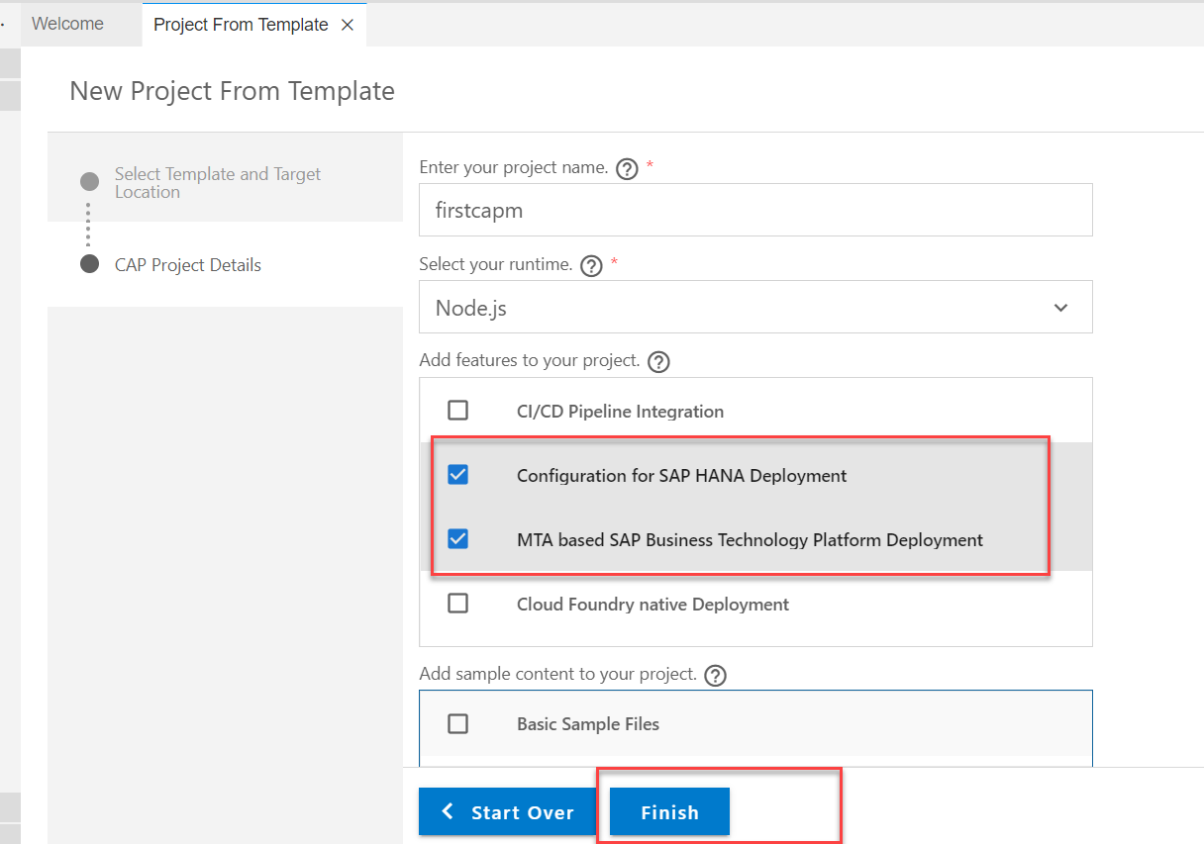
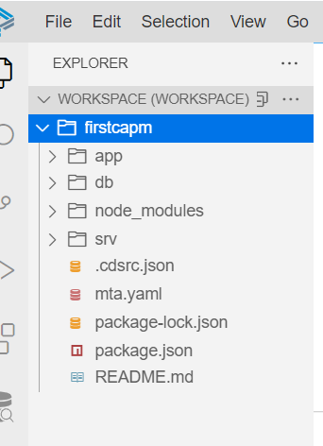
Creating First CAPM Project
After starting the dev space open the projects folder in the BAS Tool.
Once the folder is open in your system click on Start from template and select CAP Project.
After clicking on the finish button your project will be generated which you can see in the Files Section

Slide 24
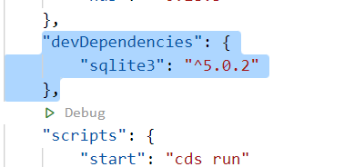
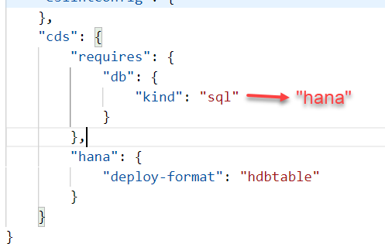
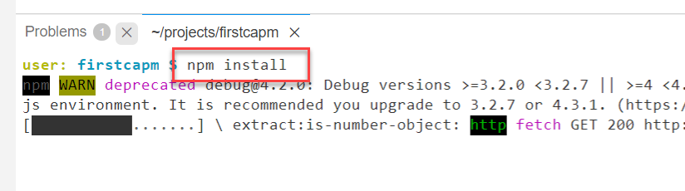
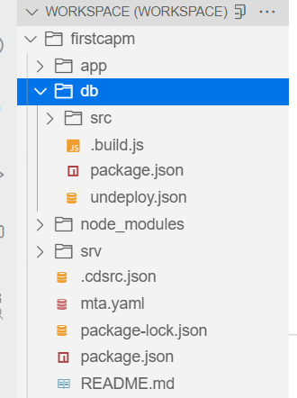
Configuring the Project for HANA Cloud
Once the project is Created we need to configure our project for the HANA Cloud specific development.
To do that
Open the Package.json file and change the kind form sql to hana under the cds section.
Remove the sqlite3 form the devDependencies.
After doing that install all the dependencies of the project using the command
“npm install”
Install the hana-cli in the dev space globally using the command “npm install hana-cli”
Use this if the above doesn't work “npm install –g hana-cli@2.202110.1”
Now to configure the db folder for HANA project we have to use the command
“hana-cli createModule”
After successfully completing all these steps our project is configured for HANA Cloud.
And our project structure will look like this:

Slide 25
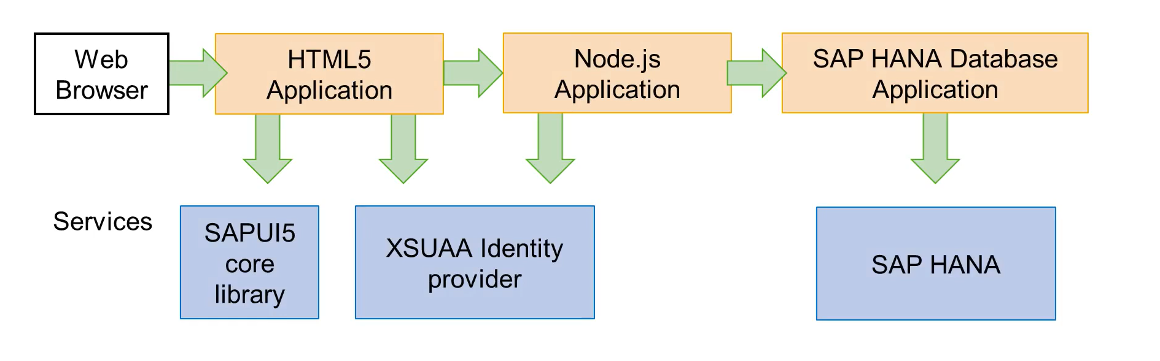
What is Multi-Target Application (MTA)
A Multi-target Application (MTA) is comprised of multiple parts (modules), created with different technologies and deployed to different targets, but with a single, common lifecycle.
It is a good practice to use separate applications for the 3 tiers: front-end, application and database. So a full-stack application is typically made of the combination of multiple applications and service instances.
That’s why SAP extended the Cloud Foundry standards, introducing the concept of Multi-Target Application

Slide 26

Exercise
In this exercise we will create a simple service in our project and expose it.
For this exercise we will go to the srv folder and create a new file, let’s name it “myfirstservice.cds” put the content in this file from the git link provided for this file.
Once the above step is done, then we will create another file and name it as “myfirstservice.js” in this file we will create the function in JavaScript.
Exercise Code links:
myfirstservice.cds
myfirstservice.js

Slide 27

Introduction to Git and GitHub
Git is a version control system that lets you manage and keep track of your source code history.
GitHub is a cloud-based hosting service that lets you manage Git repositories.
Git HUB is a central repository to store all the code. Git is a distributed repository management system, which allows development teams to organize and sync their development code.
Use Case- I am working as a Fiori Developer in an MNC and I want to share my code with fellow developers, currently I am downloading the zip/tar file and sharing over email.
This way we will have piles of emails in our account,
especially when we work in a team of size 40 developers it becomes very hard to sync changes.
There is version control. Last night my app was stable, I made some changes this morning which messed up the whole project. I some how pray to god that can you please take me in past.
In a big team, many developers touching each other’s code and it’s hard to blame someone who disrupt the code.
It is also very hard to merge changes when done in same file.
As a developer, I am using BAS today, tomorrow I will use VS Code and next day Web IDE and very next week Atom. How can I easily port my code between these tools.
You can install git in local machine using below link (however, it comes along with all dev tools)
https://git-scm.com/downloads

Slide 28

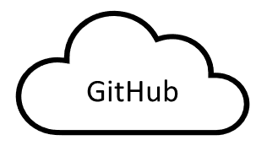
How GitHub Works and commands in Git
We will see some important commands related to Git and will see how GitHub works.
Some important commands to use git.
git Init: It is used to initialize a new Git Repository in the system.
git add <filename>: It is used to stage the changes of the file to git repository. We can use ‘git add .’ to stage the changes of all files.
git commit: It is used to commit all the staged changes with a message.
git reset hard: Discard all the staged changes and discard the changes in all the files.
git push: It is used to push all the changes in the git repository.
git pull: It is used to pull the new changes made by other users in the project.
git status: It is used to check the status
git clone: It is used to clone a repository.
git remote add <repo URL>: Add a local repository to a remote repository.
Project (or any kind of project)
User (Anubhav)
But how all users will work on the project at a same time?
Anubhav’s local machine
Here GitHub comes into picture
Users which are working on the different parts of the same project on different Platforms (BAS, VS Code, Web IDE)
Project Repository
The project will be kept in a repository in the GitHub

Slide 29
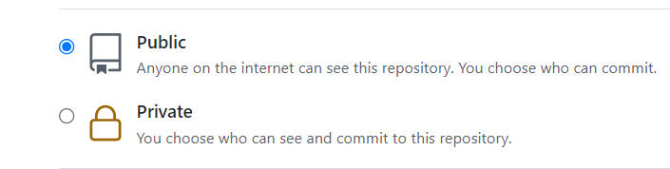
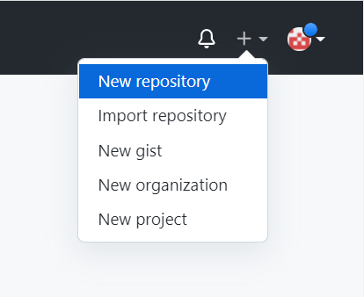
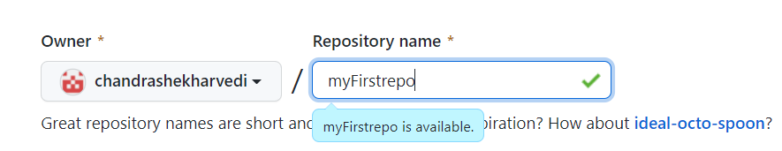
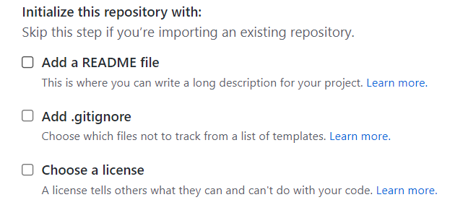
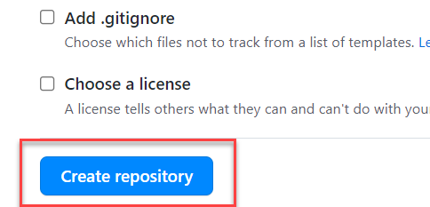
Steps to Create a new git Repository
Step by Step process to create a git repository in GitHub. First of all you must have a GitHub account, if not then go to this link https://github.com/signup?source=login and create a new Account.
Step 1: Click on the plus button in the top right corner of the screen and select ‘New Repository’.
Step 2: Type a short, memorable name for your repository. And give a description (optional).
Step 3: Select the type of repository. Public or Private
Step 4: Set how you want to Initialize the repository.
Step 5: Click on Create Repository. Your Repository will be created.
Repository Created Successfully

Slide 30

Questions

Slide 31

End of Day 2

Slide 32

Anubhav Oberoy

Slide 33


We’re committed to empower you to be
Most Desirable Resource
through powerful training solutions.
We build the workforce of the future.
250+
Corporate Clients
30,000+
Learners Trained
25000+
Learners Placed
FREE WEBINARS
Sign up for free webinars with industry experts every fortnight!
Enroll Now!
Contact us today!
https://anubhavtrainings.com/

Slide 34




More from AnubhavTrainings.com

Slide 35
Title
Content

